Slide 1


Bio Key
BIOMETRIC AUTHENTICATION
TEAM: ~RICH. FAIR. BANK~
JOSE MORENO - ALLISON RAPOPORT – PARKER SARSFIELD
KEN SCHNALL - XINCHENG YOU

Slide 2
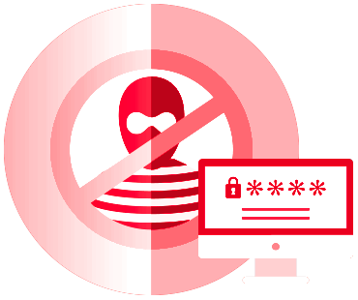


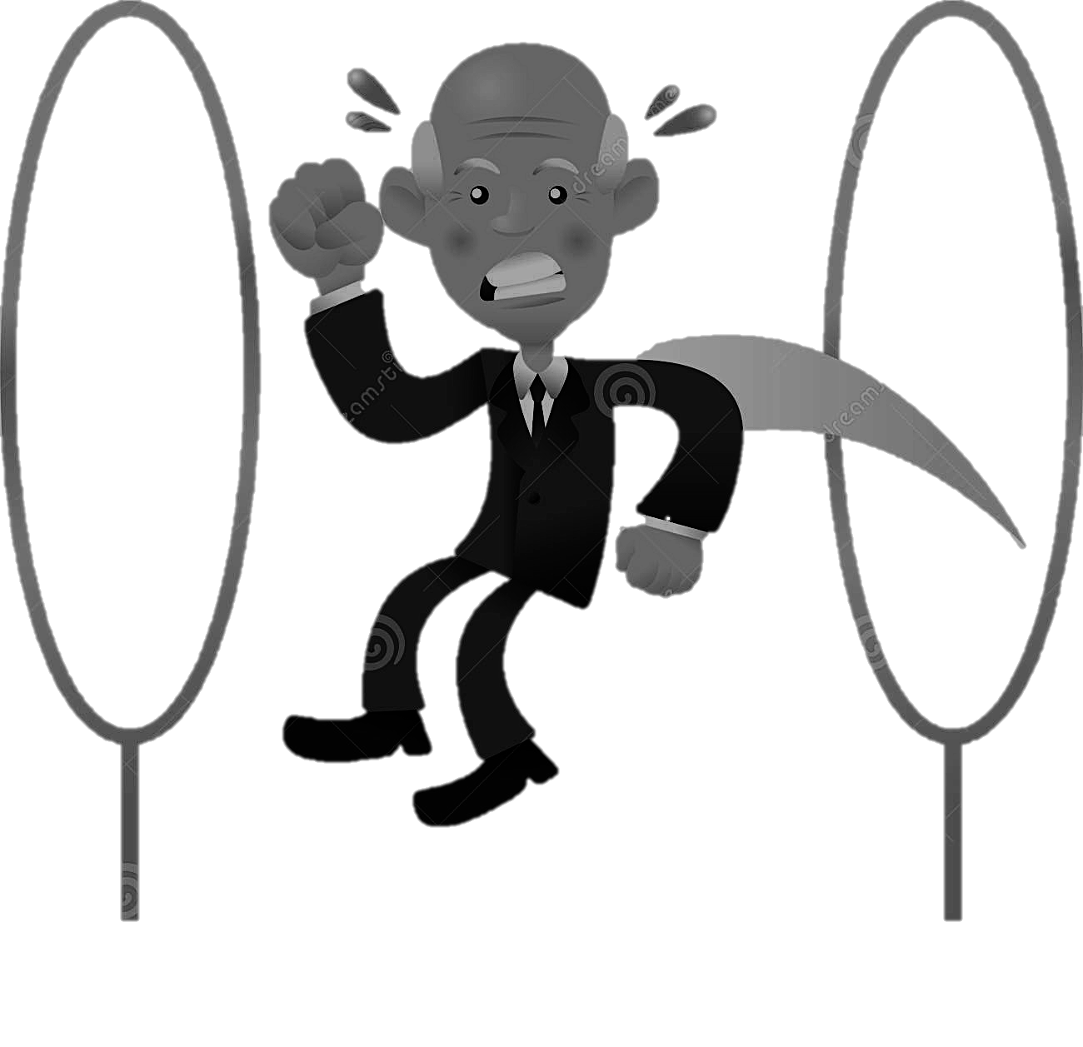

M OT I VE
PROBLEM
TRENDS
SOLUTION
SECURITY
BIOMETRIC
DATA
FRAUD
PREVENTION
USER
EXPERIENCE
WEARABLES
N-FACTOR
AUTHENTICATION
Notes:
Security—the need for two factor authentication in clever ways that haven’t been done before; arguably more secure than text-based authentication
Without sacrificing the quality of the customer’s experience
Less intrusive/awkward, more interesting

Slide 3



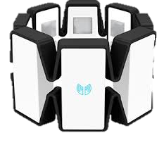
CONCEPT
1
2
Notes:
Use the Myo Armband as a layer of authentication for a customer’s card data
Both intuitive and secure
Fraud – reduce cost for the bank

Slide 4






TECH

Slide 5


FUTURE
+
+
=
WEARABLE
DEVICE
BIOMETRIC
DATA
MACHINE
LEARNING
OPPORTUNITY

